Slide 1
DIGITAL AD PRODUCTS MENU & SPECS

Slide 2
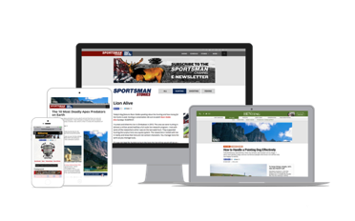
Table of Contents
Desktop
Super Header (1400x500)(New)
Billboard (970x250)(New)
Half Page (300x600)
Medium Rectangle( 300x250)
Interstitial (600x600)
Video Interstitial (600x600)
Mobile
Leader Board (320x50)
Medium Rectangle (300x250)
Interstitial (320x480)
Tablet
Leader Board (728x90)
Half Page (300x600)
Medium Rectangle (300x250)
Interstitial (600x600)
Email
E-Newsletters (300x250)
E Blasts
Native
Articles
Ad Units (Single In Stream / Multi Unit)
Sponsored (240x60, 728x90,300x250)
Custom
Video
Pre Roll
Tactics
Roadblocks (2 viewable ads)
Take Over ( All 4 ad spaces on page)
Genre Sponsorship (240x60)
Mobile
Email
Video

Slide 3
DESKTOP

Slide 4
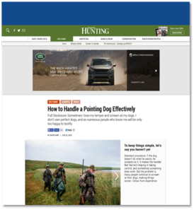
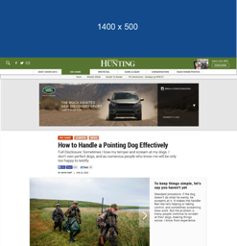
Superheader (NEW 2016)
1400 x 200 (Expands to 1400 x 500)
1400 x 200
Initial Dimensions (WxH in Pixels): 1400 x 200
Maximum Expanded Dimensions (WxH in Pixels): 1400 x 500
Formats: GIF, JPG, PNG, HTML5, Javascript
Initial File Size Max: 100 KB
Subsequent Max User Initiated File Load Size: 300 KB
Max Video and Animation Frame Rate: 24 FPS
Max Animation Length: 15 seconds
Max Video Length: 30 seconds
Audio: User-initiated: Tap
Minimum Required Controls: Control = “Close X” on expanded panel and “Expand” on collapsed panel Font = 8pt (11px) - 16pt (21px) Retract Feature = Either tap to close/expand Video may be played in native player which has standard controls Custom video players must include: Play, Pause, Mute (volume control to zero (0) output may be included instead of or in addition to Mute control)
Video must include:
Play, Pause, Mute (volume control to zero (0) output may be included instead of or in addition to Mute control)
Labeling Requirements, Font Size, etc: Ad unit content must be clearly distinguishable from normal webpage content (i.e. ad unit must have clearly defined borders and not be confused with normal page content)
Submission Lead Time: 10 business days
Ad clickthrough rate varies according to placement (position on screen) and ad format (shape and size). The traditional full-banner performs very poorly compared to skyscrapers, (300x600) the ubiquitous medium rectangle (300x250) and the newer large rectangle format. (1400x200 exp, 970x250 )
Historical Performance for this Ad Size: 2.27% CTR
Expanded
Live Example:
Superheader

Slide 5
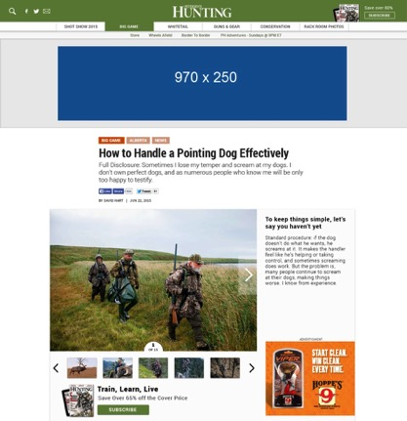
Billboard (NEW 2016)
970 x 250
Dimensions (WxH in Pixels): 970 X 250
Formats: GIF, JPG, PNG, HTML5, Javascript
Initial File Size Max: 200 KB
Subsequent Max User Initiated File Load Size: 300KB
Max Video and Animation Frame Rate: 24 FPS
Max Animation Length: 15 seconds
Max Video Length: 30 seconds
Audio: User-initiated: Tap
Minimum Required Controls: Control = “Close X” on expanded panel and “Expand” on collapsed panel Font = 8pt (11px) - 16pt (21px) Retract Feature = Either tap to close/expand Video may be played in native player which has standard controls Custom video players must include: Play, Pause, Mute (volume control to zero (0) output may be included instead of or in addition to Mute control)
Labeling Requirements, Font Size, etc: Ad unit content must be clearly distinguishable from normal webpage content (i.e. ad unit must have clearly defined borders and not be confused with normal page content)
Submission Lead Time: 5 business days
Ad clickthrough rate varies according to placement (position on screen) and ad format (shape and size). The traditional full-banner performs very poorly compared to skyscrapers, (300x600) the ubiquitous medium rectangle (300x250) and the newer large rectangle format. (1400x200 exp, 970x250 )
Historical Performance for this Ad Size: .57% CTR
Live Example:
Billboard

Slide 6
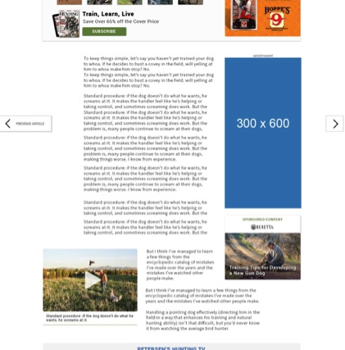
Half Page
300 x 600
Initial Dimensions (WxH in Pixels): 300 x 600
Maximum Expanded Dimensions (WxH in Pixels): 600 x 600
Formats: GIF, JPG, PNG, HTML5, Javascript
Initial File Size Max: 60 KB
Subsequent Max User Initiated File Load Size: 200 KB
Max Video and Animation Frame Rate: 24 FPS
Max Animation Length: 15 seconds
Max Video Length: 30 seconds
Audio: User-initiated: Tap
Minimum Required Controls: Control = “Close X” on expanded panel and “Expand” on collapsed panel Font = 8pt (11px) - 16pt (21px) Retract Feature = Either tap to close/expand Video may be played in native player which has standard controls Custom video players must include: Play, Pause, Mute (volume control to zero (0) output may be included instead of or in addition to Mute control)
Labeling Requirements, Font Size, etc: Ad unit content must be clearly distinguishable from normal webpage content (i.e. ad unit must have clearly defined borders and not be confused with normal page content)
Submission Lead Time: 5 business days
Historical Performance for this Ad Size: .20% CTR
Live Example:
Half Page

Slide 7
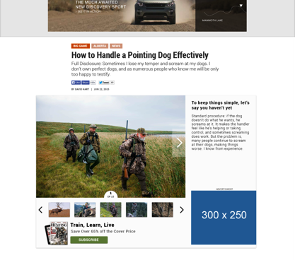
Medium Rectangle
300 x 250
Initial Dimensions (WxH in Pixels): 300 x 250
Maximum Expanded Dimensions (WxH in Pixels): 600 x 600
Formats: GIF, JPG, PNG, HTML5, Javascript
Initial File Size Max: 60 KB
Subsequent Max User Initiated File Load Size: 200 KB
Max Video and Animation Frame Rate: 24 FPS
Max Animation Length: 15 seconds
Max Video Length: 30 seconds
Audio: User-initiated: Tap
Minimum Required Controls: Control = “Close X” on expanded panel and “Expand” on collapsed panel Font = 8pt (11px) - 16pt (21px) Retract Feature = Either tap to close/expand Video may be played in native player which has standard controls Custom video players must include: Play, Pause, Mute (volume control to zero (0) output may be included instead of or in addition to Mute control)
Labeling Requirements, Font Size, etc: Ad unit content must be clearly distinguishable from normal webpage content (i.e. ad unit must have clearly defined borders and not be confused with normal page content)
Submission Lead Time: 5 business days
Historical Performance for this Ad Size: .04% CTR
Live Example:
Medium Rectangle

Slide 8
Leaderboard
728x90
729x90
Initial Dimensions (WxH in Pixels): 728x90
Maximum Expanded Dimensions (WxH in Pixels): 600x600
Formats: GIF, JPG, PNG, HTML5, Javascript
Initial File Size Max: 60 KB
Subsequent Max User Initiated File Load Size: 200 KB
Max Video and Animation Frame Rate: 24 FPS
Max Animation Length: 15 seconds
Max Video Length: 30 seconds
Audio: User-initiated: Tap
Minimum Required Controls: Control = “Close X” on expanded panel and “Expand” on collapsed panel Font = 8pt (11px) - 16pt (21px) Retract Feature = Either tap to close/expand Video may be played in native player which has standard controls Custom video players must include: Play, Pause, Mute (volume control to zero (0) output may be included instead of or in addition to Mute control)
Labeling Requirements, Font Size, etc: Ad unit content must be clearly distinguishable from normal webpage content (i.e. ad unit must have clearly defined borders and not be confused with normal page content)
Submission Lead Time: 5 business days
Historical Performance for this Ad Size: .36% CTR
Live Example:
Leaderboard

Slide 9
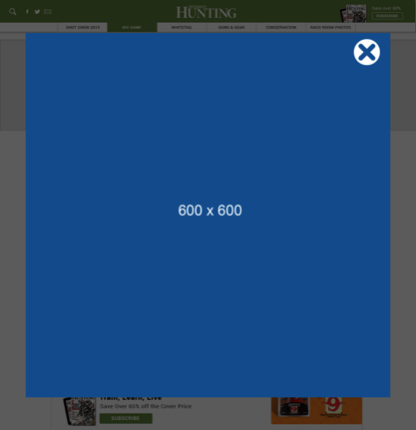
Interstitial
600 x 600
Initial Dimensions (WxH in Pixels): 600 x 600
Maximum Expanded Dimensions (WxH in Pixels): Expansion not Allowed for this unit
Formats: GIF, JPG, PNG, HTML5, Javascript
Initial File Size Max: 200 KB
Subsequent Max User Initiated File Load Size: 300 KB
Max Video and Animation Frame Rate: 24 FPS
Max Animation Length: 15 seconds
Max Video Length: 30 seconds
Audio: User-initiated: Tap
Minimum Required Controls: “Close” control provided by browser window if ad displays in its own browser window. If overlaid on target page, include “Close X” button. Font = 8pt (11px) - 16pt (21px)
Labeling Requirements, Font Size, etc: Ad unit content must be clearly distinguishable from normal webpage content (i.e. ad unit must have clearly defined borders and not be confused with normal page content)
Submission Lead Time: 5 business days
Historical Performance for this Ad Size: 1.93% CTR

Slide 10
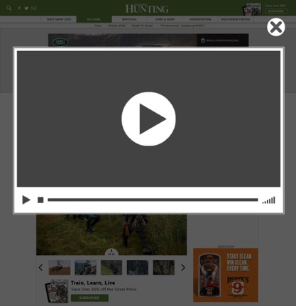
Video Interstitial
600 x 600
Initial Dimensions (WxH in Pixels): 300 x 250
Maximum Expanded Dimensions (WxH in Pixels): Expansion not Allowed for this unit
Formats: GIF, JPG, PNG, HTML5, Javascript
Initial File Size Max: 200 KB
Subsequent Max User Initiated File Load Size: 300 KB
Max Video and Animation Frame Rate: 24 FPS
Max Animation Length: 15 seconds
Max Video Length: 15 seconds
Audio: User-initiated: Tap
Minimum Required Controls: “Close” control provided by browser window if ad displays in its own browser window. If overlaid on target page, include “Close X” button. Font = 8pt (11px) - 16pt (21px)
Video must include:
Play, Pause, Mute (volume control to zero (0) output may be included instead of or in addition to Mute control)
Labeling Requirements, Font Size, etc: Ad unit content must be clearly distinguishable from normal webpage content (i.e. ad unit must have clearly defined borders and not be confused with normal page content)
Submission Lead Time: 5 business days
Historical Performance for this Ad Size: CTR 1.93%

Slide 11
MOBILE

Slide 12
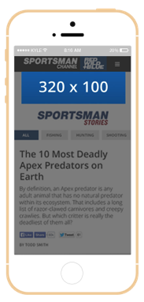
Mobile Leaderboard
320 x 100 (320 x 50)
Initial Dimensions (WxH in Pixels): 320 x 100 (320 x 50, 300 x 100, 300 x 50)
Maximum Expanded Dimensions (WxH in Pixels): 320x416, Full Screen (Technical restrictions may apply for full screen expansion.)
Formats: HTML5 required, GIF, JPG, PNG for backup
Initial File Size Max: 35 KB
Secondary Polite Load Max: Best Practice
Max Video and Animation Frame Rate: 24 FPS
Max Animation Length: 15 seconds
Max Video Length: 30 seconds
Audio: User-initiated: Tap
Minimum Required Controls: Control = “Close X” on expanded panel and “Expand” on collapsed panel Font = 8pt (11px) - 16pt (21px) Retract Feature = Either tap to close/expand Video may be played in native player which has standard controls Custom video players must include: Play, Pause, Mute (volume control to zero (0) output may be included instead of or in addition to Mute control)
Labeling Requirements, Font Size, etc: Ad unit content must be clearly distinguishable from normal webpage content (i.e. ad unit must have clearly defined borders and not be confused with normal page content)
Submission Lead Time: 5 business days
Implementation Notes & Best Practices: Ensure images are mobile web optimized; do not use Flash™ assets; landing pages must be mobile optimized; include dimensions in file name; use MRAID specifications when appropriate
Historical Performance for this Ad Size: 320x50 .02% CTR / 320x100 .08% CTR
Live Example:
Mobile Banner (Only view on a smartphone)

Slide 13
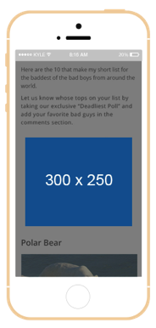
Medium Rectangle
300 x 250
Initial Dimensions (WxH in Pixels): 300 x 250
Maximum Expanded Dimensions (WxH in Pixels): Expansion not allowed for this unit
Formats: HTML5 required, GIF, JPG, PNG for backup
Initial File Size Max: 35 KB
Secondary Polite Load Max: Best Practice
Max Video and Animation Frame Rate: 24 FPS
Max Animation Length: 15 seconds
Max Video Length: 30 seconds
Audio: User-initiated: Tap
Minimum Required Controls: Control = “Close X” on expanded panel and “Expand” on collapsed panel Font = 8pt (11px) - 16pt (21px) Retract Feature = Either tap to close/expand Video may be played in native player which has standard controls Custom video players must include: Play, Pause, Mute (volume control to zero (0) output may be included instead of or in addition to Mute control)
Labeling Requirements, Font Size, etc: Ad unit content must be clearly distinguishable from normal webpage content (i.e. ad unit must have clearly defined borders and not be confused with normal page content)
Submission Lead Time: 5 business days
Implementation Notes & Best Practices: Ensure images are mobile web optimized; do not use Flash™ assets; landing pages must be mobile optimized; include dimensions in file name; use MRAID specifications when appropriate
Historical Performance for this Ad Size: .11% CTR

Slide 14
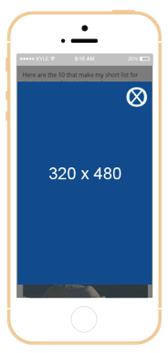
Interstitial
320 x 480
Initial Dimensions (WxH in Pixels): 320 x 480
Maximum Expanded Dimensions (WxH in Pixels): Expansion not allowed for this unit.
Formats: HTML5 required, GIF, JPG, PNG for backup
Initial File Size Max: 35 KB
Subsequent Max User Initiated File Load Size: 100 KB
Max Video and Animation Frame Rate: 24 FPS
Max Animation Length: 15 seconds
Max Video Length: 30 seconds
Audio: User-initiated: Tap
Minimum Required Controls: Control = “Close X” on expanded panel and “Expand” on collapsed panel Font = 8pt (11px) - 16pt (21px) Retract Feature = Either tap to close/expand Video may be played in native player which has standard controls Custom video players must include: Play, Pause, Mute (volume control to zero (0) output may be included instead of or in addition to Mute control)
Labeling Requirements, Font Size, etc: Ad unit content must be clearly distinguishable from normal webpage content (i.e. ad unit must have clearly defined borders and not be confused with normal page content)
Submission Lead Time: 10 business days
Implementation Notes & Best Practices: Ensure images are mobile web optimized; do not use Flash™ assets; landing pages must be mobile optimized; include dimensions in file name; use MRAID specifications when appropriate

Slide 15
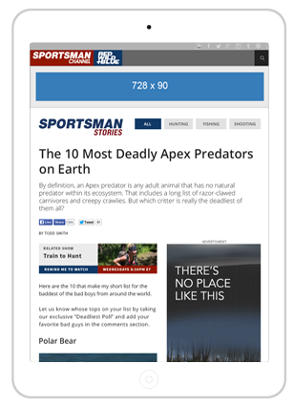
Leaderboard
728 x 90
Initial Dimensions (WxH in Pixels): 728 x 90
Maximum Expanded Dimensions (WxH in Pixels): Expansion not allowed for this unit
Formats: HTML5 required, GIF, JPG, PNG for backup
Initial File Size Max: 60 KB
Subsequent Max User Initiated File Load Size: 200 KB
Max Video and Animation Frame Rate: 24 FPS
Max Animation Length: 15 seconds
Max Video Length: 30 seconds
Audio: User-initiated: Tap
Minimum Required Controls: Control = “Close X” on expanded panel and “Expand” on collapsed panel Font = 8pt (11px) - 16pt (21px) Retract Feature = Either tap to close/expand Video may be played in native player which has standard controls Custom video players must include: Play, Pause, Mute (volume control to zero (0) output may be included instead of or in addition to Mute control)
Labeling Requirements, Font Size, etc: Ad unit content must be clearly distinguishable from normal webpage content (i.e. ad unit must have clearly defined borders and not be confused with normal page content)
Submission Lead Time: 5 business days
Implementation Notes & Best Practices: Ensure images are mobile web optimized; do not use Flash™ assets; landing pages must be mobile optimized; include dimensions in file name; use MRAID specifications when appropriate
Historical Performance for this Ad Size: .05% CTR

Slide 16
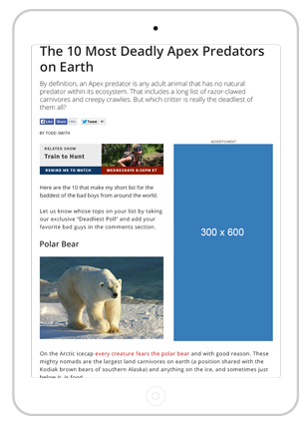
Half Page
300 x 600
Initial Dimensions (WxH in Pixels): 300 x 600
Maximum Expanded Dimensions (WxH in Pixels): Expansion not allowed for this unit
Formats: HTML5 required, GIF, JPG, PNG for backup
Initial File Size Max: 60 KB
Subsequent Max User Initiated File Load Size: 200 KB
Max Video and Animation Frame Rate: 24 FPS
Max Animation Length: 15 seconds
Max Video Length: 30 seconds
Audio: User-initiated: Tap
Minimum Required Controls: Control = “Close X” on expanded panel and “Expand” on collapsed panel Font = 8pt (11px) - 16pt (21px) Retract Feature = Either tap to close/expand Video may be played in native player which has standard controls Custom video players must include: Play, Pause, Mute (volume control to zero (0) output may be included instead of or in addition to Mute control)
Labeling Requirements, Font Size, etc: Ad unit content must be clearly distinguishable from normal webpage content (i.e. ad unit must have clearly defined borders and not be confused with normal page content)
Submission Lead Time: 5 business days
Implementation Notes & Best Practices: Ensure images are mobile web optimized; do not use Flash™ assets; landing pages must be mobile optimized; include dimensions in file name; use MRAID specifications when appropriate
Historical Performance for this Ad Size: .15% CTR

Slide 17
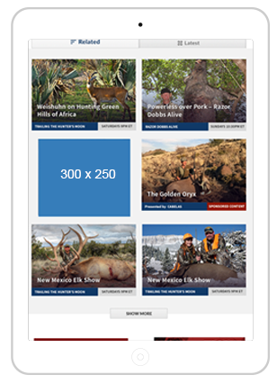
Medium Rectangle
300 x 250
Initial Dimensions (WxH in Pixels): 300 x 250
Maximum Expanded Dimensions (WxH in Pixels): Expansion not allowed for this unit
Formats: HTML5 required, GIF, JPG, PNG for backup
Initial File Size Max: 60 KB
Subsequent Max User Initiated File Load Size: 200 KB
Max Video and Animation Frame Rate: 24 FPS
Max Animation Length: 15 seconds
Max Video Length: 30 seconds
Audio: User-initiated: Tap
Minimum Required Controls: Control = “Close X” on expanded panel and “Expand” on collapsed panel Font = 8pt (11px) - 16pt (21px) Retract Feature = Either tap to close/expand Video may be played in native player which has standard controls Custom video players must include: Play, Pause, Mute (volume control to zero (0) output may be included instead of or in addition to Mute control)
Labeling Requirements, Font Size, etc: Ad unit content must be clearly distinguishable from normal webpage content (i.e. ad unit must have clearly defined borders and not be confused with normal page content)
Submission Lead Time: 5 business days
Implementation Notes & Best Practices: Ensure images are mobile web optimized; do not use Flash™ assets; landing pages must be mobile optimized; include dimensions in file name; use MRAID specifications when appropriate
Historical Performance for this Ad Size: .07% CTR

Slide 18
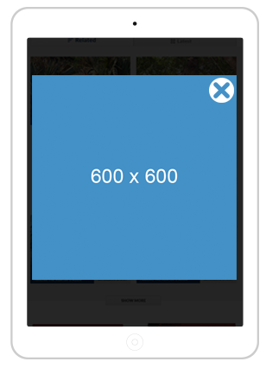
Interstitial
600 x 600
Initial Dimensions (WxH in Pixels): 600 x 600
Maximum Expanded Dimensions (WxH in Pixels): Expansion not Allowed for this unit
Formats: HTML5 required, GIF, JPG, PNG for backup
Initial File Size Max: 200 KB
Subsequent Max User Initiated File Load Size: 300 KB
Max Video and Animation Frame Rate: 24 FPS
Max Animation Length: 15 seconds
Max Video Length: 30 seconds
Audio: User-initiated: Tap
Minimum Required Controls: “Close” control provided by browser window if ad displays in its own browser window. If overlaid on target page, include “Close X” button. Font = 8pt (11px) - 16pt (21px)
Labeling Requirements, Font Size, etc: Ad unit content must be clearly distinguishable from normal webpage content (i.e. ad unit must have clearly defined borders and not be confused with normal page content)
Submission Lead Time: 10 business days
Implementation Notes & Best Practices: Ensure images are mobile web optimized; do not use Flash™ assets; landing pages must be mobile optimized; include dimensions in file name; use MRAID specifications when appropriate

Slide 19
EMAIL PRODUCTS

Slide 20
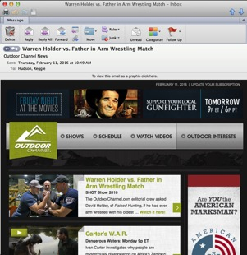
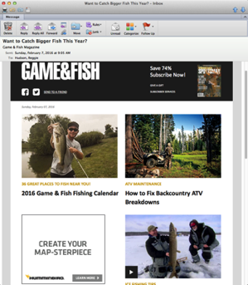
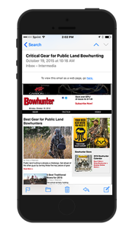
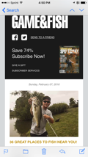
E-Newsletters
Purpose: e-newsletters sent to inform our audience of fresh new content across the OSG network.
Subscriber Base: OSG has acquired these names through consumer promotions.
Frequency: Each brand within the OSG network operates on a different deployment frequency (see table next page).
Advertising Opportunities: In every newsletter there are two advertisement slots that surround the content and a sponsored content slot.
There are 300 x 250 ad sizes on most properties.
The sponsored content will be associated with a native campaign and will promote the sponsored content.
Materials Needed: Accepted file types are JPEG and GIF. Max file size of 40k. Please provide a click URL for the banner advertisements. We accept impression and click trackers.
Reporting: We provide a performance report on the newsletter at the end of the month or upon request.
Historical Performance*:
Hunt: Avg. CTR 3.8% / Avg. Open Rate 12%
Shoot: Avg. CTR 6.23% / Avg. Open Rate 19.9%
Fish: Avg. CTR 3.8% / Avg. Open Rate 14.3%
*Jan 2016
Notes:
Does the CTR represent ads or overall?

Slide 21
Frequency & Subscriber Totals
TITLE | FREQUENCY | DAYS | E-Newsletter Subscribers
SHOOTING Brands
Guns & Ammo | Twice weekly | Every Wed/Sat | 185,000
Shooting Times | Every Other Week | Week 1 & 3 Thursday | 65,000
Shotgun News | Every Other Week | Week 2 & 4 Thursday | 55,000
Handguns | Every Other Week | Week 1 & 3 Tuesday | 66,000
Rifle Shooter | Every Other Week | Week 2 & 4 Tuesday | 20,000
HUNTING Brands
Petersen's Hunting | Weekly | Every Wednesday | 70,000
North American Whitetail | Weekly | Every Thursday | 32,000
Game & Fish | Weekly | Every Sunday | 155,000
Petersen's Bowhunting | Every Other Week | Week 2 & 4 Thursday | 48,000
Bowhunter | Every Other Week | Week 1 & 3 Tuesday | 54,000
Wildfowl | Every Other Week | Week 1 & 3 Friday | 15,000
Gun Dog | Every Other Week | Week 2 & 4 Wednesday | 17,000
FISHING Brands
In-Fisherman | Weekly | Every Tuesday | 83,000
Florida Sportsman | Weekly | Every Friday | 40,000
Fly Fisherman | Every Other Week | Week 2 & 4 Friday | 37,000
Game & Fish | Weekly | Every Sunday | 155,000
BassFan | TBD | TBD | 5,000
TV Brands
Sportsman Channel | Bi-Monthly | Every Tuesday | 85,000
Outdoor Channel | Weekly | Every Tuesday | 33,000
World Fishing Network | Weekly | Every Other Thursday | 30,000

Slide 22
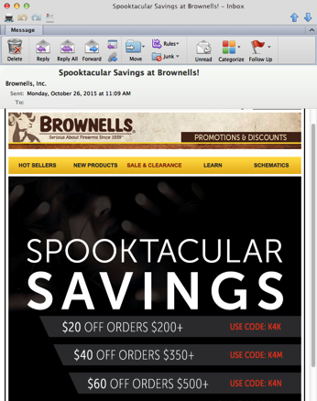
E-Blasts
Purpose: OSG uses dedicated e-blasts to connect our clients with our user base at 100% share of voice. Deliver a message directly to our audiences inbox.
Subscriber Base: Magazine readers opt-in to be sent promotions from OSG partners.
Frequency: The E-blast deployment is determined by the advertiser.
Materials Needed: Accepted file types are JPEG, GIF, Text and HTML. Max file size of 70k. Please provide a click URL for the banner advertisements. We accept impression and click trackers.
Recommended dimensions are 600 x 800.
For HTML creative, the image files must be hosted on advertisers server.
Reporting: We provide a performance report on the newsletter at the end of the month or upon request.
Notes: These lists can be segmented by category (Hunt/Fish/Shoot), by brand and can be geo-targeted.

Slide 23
VIDEO

Slide 24
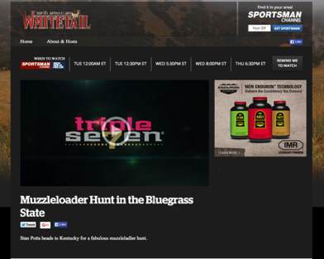
Video Pre-Roll
Varies
Description:
Short form online advertising targeted to relevant content channels and/or audience groups. The companion banner provides extra brand promotion. Pre-roll video plays prior to video content, companion banner is along right side of player. Best uses of pre-roll are converted TV spots or short form advertising on the web targeted to relevant content channels, desired audience groups, etc.
Companion Banner Specs: See 300 x 250 or 300 x 600 specs
Video Max Duration::15sec max (:30sec skippable)
Video max file size: 2 GB
Audio: User initiated
Third-party serving: VAST & VPAID compliant
Third-party tracking: Optional (Clicks, Impression Start, First Quartile, Mid Quartile, Third Quartile, Completion)
Formats:
Low Definition Renditions (LD MP4/h264 - Main) – Dimensions: 640x360; Video Bitrate: 600 kbit/s; Audio Bitrate: 96 kbit/s; Frame Rate: Same as source. If Frame Rate is not specified, it is 25 by default; Video Codec: h264; Profile: Main; Advanced Codec Options: cabac=off, ref=2, max-bframe=8, level=2.1; Audio Codec: aac; 2 Pass Encoding: Yes; Constant Bitrate: No; De–interlacing: Auto; Keyframe Period in Frames: ~25
Standard Definition Renditions (SD MP4/h264 - Main) – Dimensions: 854x480; Video Bitrate: 800 kbit/s; Audio Bitrate: 128 kbit/s; Frame Rate: Same as source. If Frame Rate is not specified, it is 25 by default; Video Codec: h264; Profile: Main; Advanced Codec Options: cabac=off, ref=2, max-bframe=8, level=3.0; Audio Codec: aac; 2 Pass Encoding: Yes; Constant Bitrate: No; De–interlacing: Auto; Keyframe Period in Frames: ~25
High Definition Renditions (HD MP4/h264 - Main) – Dimensions: 1280x720; Video Bitrate: 1500 kbit/s; Audio Bitrate: 128 kbit/s; Frame Rate: Same as source. If Frame Rate is not specified, it is 25 by default; Video Codec: h264; Profile: Main; Advanced Codec Options: cabac=off, ref=2, max-bframe=8, level=3.1; Audio Codec: aac; 2 Pass Encoding: Yes; Constant Bitrate: No; De–interlacing: Auto; Keyframe Period in Frames: ~25
Full Definition Renditions (FHD MP4/h264 - Main) – Dimensions: 1920x1080; Video Bitrate: 2000 kbit/s; Audio Bitrate: 128 kbit/s; Frame Rate: Same as source. If Frame Rate is not specified, it is 25 by default; Video Codec: h264; Profile: High; Advanced Codec Options: cabac=off, ref=2, max-bframe=8, level=4.0; Audio Codec: aac; 2 Pass Encoding: Yes; Constant Bitrate: No; De–interlacing: Auto; Keyframe Period in Frames: ~25
Historical Performance for this Ad Size: 1.88% CTR Desktop / Tablet CTR5.08% / Mobile CTR 3.53%
Live Example:
Video Pre-Roll

Slide 25
NATIVE

Slide 26
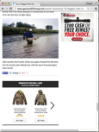
Native
OSG strives to develop custom, native content that benefits both the reader and our clients – informative, engaging and entertaining.
FORM
Native ads match the visual design of the experience they live within (on any device), and look and feel like natural content.
FUNCTION
Native ads must behave consistently with the native user experience, and function just like natural content.

Slide 27
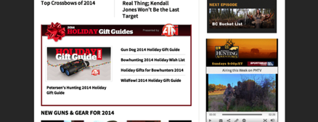
Native Ad Units
In-stream Single Story Unit – This ad unit includes the feature image of the content, a subject line and the sponsor’s logo.
In-stream Collection Unit – This ad unit is an aggregate of multiple stories within an advertisers native program. This unit will include a feature image, sponsor logo, the subject line of the highlighted piece of content, and the subject line for all other content developed in the plan.
Notes:
Add Image to the right - RH

Slide 28
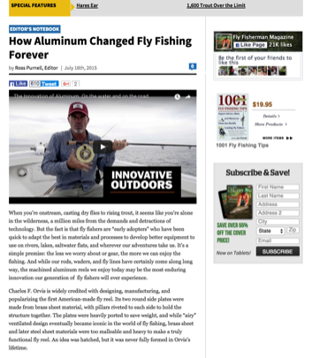
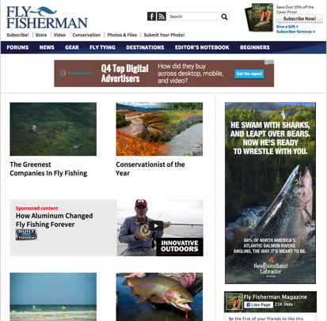
Native Ads and Articles
Example
Notes:
Add images in - RH

Slide 29
Custom Articles
Custom Articles are an editorial piece(s) written by the OSG staff that integrates an advertiser via text, video, photo(s) or links. The content is reviewed and approved by client prior to publishing.
Options:
Product Review - Client must be willing to send a sample for review. If the item is not easily shippable or is a high-value item, this must be discussed with the editorial staff before the plan is finalized.
Company/Brand Overview - This is an article that relates to the client’s brand and/or company, not to a singular product or item. This is often a good option for fast growing companies or companies with only one or two products.

Slide 30
Custom Content Platforms
Unique content and/or destination developed by the OSG development and editorial teams in collaboration with client.
Branded native ad units served across the OSG network to drive and support engagement with the content.
Web site development, copy, creative etc

Slide 31
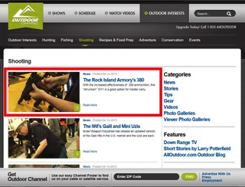
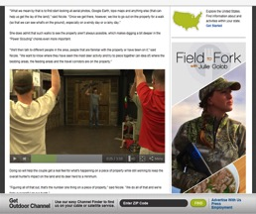
Native Video
Outdoor Channel – Digital
Video Content
Stand-Alone Video
Video Content Pieces
Stand –Along Video Content Piece
Video Tip or How-To
2-3 minutes long featuring a product and examples of use or purpose of product
Placed by Genre that applies – Hunting/Shooting/Fishing etc.
Embedded Videos
Used to supplement an article
Generally a product description/overview
Embedded Video

Slide 32
Native Performance
Desktop
.53% CTR
3:37 Time Spent
Tablet
.55% CTR
3:18 Time Spent
Mobile
.60% CTR
4:14 Time Spent
Native Ads on OSG Properties Perform 4x better than Non Native
Time on Site Increases by 132%
* Internal OSG Data

Slide 33
SPONSORSHIPS

Slide 34
Sponsored Content
Association with relevant original content created by OSG staff.
Varying topics can be selected from editorial calendar for advanced planning and increased relevance.
Native ad units served across OSG network to drive consumer engagement with the content.
A logo and/or brand placed in the top right corner of the article, with a hyperlink to a website.
The article will be an original piece, a feature story or news rewrite based on current events.
Franchises
G&A Madness
Best Concealed Carry State
Deer Season 2016
Gift Guides
Mother’s Day
Father’s Day
Holiday
Notes:
Add G&A Madness, Gift Guide and some OC image

Slide 35
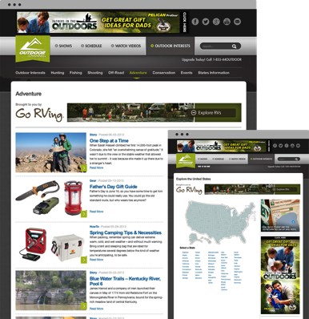
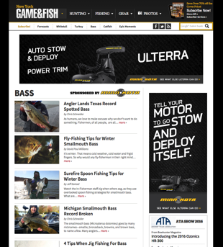
Genre Sponsorship
Get Your Brand Seen
Sponsor sections of the sites that align with your brand
OC.com: Logo included in page Header
Static Image with Click URL
Length – 1week (min) to 1 month (max)
Genre landing page only
IM Properties: a 240x60 placed in relevant section
Notes:
GAF Minn Kota Cat Page & OC Go Rving cat page

Slide 36
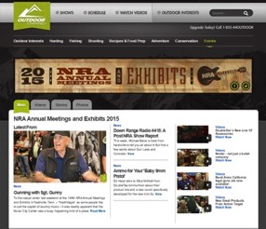
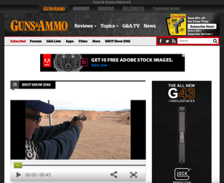
Event Sponsorship
Sponsor an Event
Tradeshows (ATA, NRA and ICAST, Bassmaster Classic)
OSG makes available daily live video stream.
Each video segment will usually last 20 minutes to one hour.
All LIVE segments are recorded and published to the site(s) for on-demand viewing.
6 to 10 short videos per day
Video showcasing new product at client’s booth
Daily live video stream
Daily photo gallery
Newsletter and Social promotion
ROS Banner Schedule & Sponsor Logo on Event Pages
Presenting or Participating levels available
Notes:
Shot Show on AMO & NRA on OC

Slide 37
RICH MEDIA

Slide 38
Rich Media
Development Guidelines
Specs:
Maximum Initial and Polite/Secondary Download: 200k (user-initiated video must utilize a polite download and should not exceed 3MB)
Maximum Number of Panels: Four
Maximum Frames Per Second (FPS): 30 fps
Audio: Initiated by user click (default state is muted) Must have an obvious mute button
In-Banner Video:
Maximum file size: 3 MB
Maximum length: 30 seconds
Video controls: Play, Pause, Mute, ‘Click for Audio’
Video may autostart
Video can be streaming or progressive download
Expandable Ad Specifications:
300×250: 600 x 250 (expands left and down)
728×90: 728 x 315 (expands down)
Expand/Close Button: must be clearly defined, method can be click or rollover (must be the same for both expand and close)
Ads that auto expand upon page load (Reverse Expandable) can only remain expanded for 5 seconds and must be capped at one per user per day. After the first encounter, any ad expansion must be user-initiated
All expanding ads must be third party served
Floating Elements:
Maximum size: 500×500
Maximum play time: 10 seconds
Maximum pause time of 3 seconds over any given area
Must have a close button on floating element
Must be clearly labeled as an advertisement
Ads may disappear or land onto existing ad spots
Ads can originate on either side of the screen
Floating elements must be frequency capped at one per user per day Hot Spots:
Should not be larger than 1/4 size of the ad
Initiated by user resting on hot spot for at least 1 second
Cannot play audio
General Ad Specifications:
All ads must feature a clearly defined border
Ads cannot have a transparent background
Rising Stars
OSG is now supporting the following Rising Star ad units. For more information and specifications please visit the IAB or reach out to your OSG sales contact
Billboard
Filmstrip
Portrait
Pushdown Showcase
Sidekick
Videoscape

Slide 39
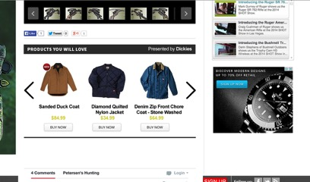
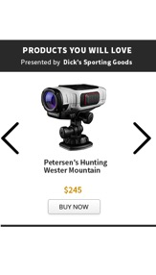
E-Commerce
The Outdoorsman E-commerce widget makes it easy to display your store seamlessly within highly relevant content across our entire digital network.
It reduces friction – it makes it easier for the reader to transition the customer between product discovery to purchase
The widget is responsive and automatically adapts to your customers’ screen size — laptops, tablets, and smart phones.

Slide 40
Superheader
1400 x 200 (Expands to 1400 x 500)
1400 x 200
Initial Dimensions (WxH in Pixels): 1400 x 200
Maximum Expanded Dimensions (WxH in Pixels): 1400 x 500
Formats: GIF, JPG, PNG, HTML5, Javascript
Initial File Size Max: 100 KB
Subsequent Max User Initiated File Load Size: 300 KB
Max Video and Animation Frame Rate: 24 FPS
Max Animation Length: 15 seconds
Max Video Length: 30 seconds
Audio: User-initiated: Tap
Minimum Required Controls: Control = “Close X” on expanded panel and “Expand” on collapsed panel Font = 8pt (11px) - 16pt (21px) Retract Feature = Either tap to close/expand Video may be played in native player which has standard controls Custom video players must include: Play, Pause, Mute (volume control to zero (0) output may be included instead of or in addition to Mute control)
Video must include:
Play, Pause, Mute (volume control to zero (0) output may be included instead of or in addition to Mute control)
Labeling Requirements, Font Size, etc: Ad unit content must be clearly distinguishable from normal webpage content (i.e. ad unit must have clearly defined borders and not be confused with normal page content)
Submission Lead Time: 10 business days
Ad clickthrough rate varies according to placement (position on screen) and ad format (shape and size). The traditional full-banner performs very poorly compared to skyscrapers, (300x600) the ubiquitous medium rectangle (300x250) and the newer large rectangle format. (1400x200 exp, 970x250 )
Expanded

Slide 41
TARGETING

Slide 42
Targeting Capabilities
Geography: You can target line items to countries, regions, US metro areas (DMA), UK TV regions, cities, and US ZIP codes or Canadian postal code prefixes. Either search for a specific place or browse through the list of countries and drill down to the places you want to target.
Devices: You can target line items to a user’s device type or the browser it’s running:
Browser: Android, Firefox, Google Chrome, Microsoft Internet Explorer, etc. To target the line item to all versions of a particular browser, select browser name (x.x). To target the line item to versions of a browser that aren't in the list, select browser name Unknown.Unknown. For example, 4.x targets all releases of the browser between version 4 and up to, but not including version 5. That is, 4.1, 4.2 and so on.
Browser language: Chinese, English, Italian, German, etc.
Device capability: MRAID v2, Phone calls.
Device category: Desktop, Feature Phone, Smartphone, Tablet.
Manufacturer/device: Apple, BlackBerry, Ericsson, HTC, Xiaomi, and many others.
Operating system: Android, Apple iOS, Linux, Macintosh, Microsoft Windows, etc.

Slide 43
Targeting Capabilities
Connection: You can target line items to a user’s bandwidth, carrier, or user domain:
Bandwidth: Cable, DSL, etc.
Mobile carrier: AT&T, 02, etc.
User domains: You can set line items to target ads only to the domains or subdomains of the Internet service providers (ISPs) your users use to access the Internet. For example, if you target stanford.edu, you are targeting students, faculty, and staff of Stanford University only. If you target google.com, you are targeting Google employees only. You can specify top-level domains, such as .edu, and .gov, and subdomains, such as stanford.edu, and usa.gov. Invalid values include services like http://www.psychology.berkeley.edu, and www.usa.gov.
Contextual: The process that matches ads to relevant sites in the Display Network using your keywords or topics, among other factors.
Audience Targeting: The practice of targeting users according to first or third party data related to these users. Audience targeting data is often opposed to contextual or brand targeting where it is globally the advertising vehicle or website which is chosen.

Slide 44
APPENDIX

Slide 45
General Ad Requirements
Interest-Based Advertising (IBA): Include IBA self-regulation controls for ads using behavioral targeting (5 KB max file size).
Audio: Must be user-initiated. To allow for audio initiation in videos without player controls, a control may be included for user to initiate audio.
Hotspot: Not to exceed 1/4 size of ad. Initiated when cursor rests on hotspot for at least 1 sec. Must NOT initiate audio.
Defining ad space: Ad unit content must be clearly distinguishable from normal webpage content (ad unit must have clearly defined borders and not be confused with normal page content).
Max CPU: ad not to exceed 30% CPU usage during host-initiated execution.
Submission lead time: Minimum lead time for ad file submission is 5 days before campaign start.
Max number of host-initiated file requests: ad not to exceed 15 file requests during initial file load and host-initiated subload. Unlimited file requests allowed after user-interaction.
Ad clickthrough rate naturally varies according to placement (position on screen) and ad format (shape and size). The traditional full-banner performs very poorly compared to skyscrapers, the ubiquitous medium rectangle and the newer large rectangle format.

Slide 46
General Notes
Apply to all ads
File weight calculation: All files for the ad (.html, .js, .css, images, etc.) must be included as part of the maximum file weight calculation for all file load limits. Shared libraries are also included as part of the file weight calculation unless otherwise exempted (see note 5). File weights are calculated after files have been compressed into gzip format (see note 7).
2. Initial file load: Includes all assets and files necessary for completing first visual display of the Ad.
3. Host-initiated subload: where allowed, additional files may load one second after the browser domContentLoadedEventEnd event. The ad should be able to "listen" for the browser domContentLoadedEventEnd event before subsequent files beyond the initial max file size may be loaded.
4. User-initiated file size: Ads that allow additional file size for host-initiated subload also allow for unlimited file load after user-initiated interaction. User initiation is the willful act of a user to engage with an ad. Users may interact by clicking or tapping the ad, and/or rolling over an ad (or a portion of an ad).
5. Shared Libraries: Publishers are encouraged to approve the use of shared libraries for HTML5 ads and exempt them from the ad's file weight calculation. As part of the publisher's certification process, both the shared libraries and their sources must be approved before any shared libraries may be exempted from the ad's file weight.
6. Rising Star display: Rising Stars ad units are designed to be the only rich media ad unit displayed on a webpage. Because of increased file load size, displaying a Rising Stars ad unit with any other rich media unit may compromise page-load performance. Other non-rich media ads should display without compromising performance.
7. Ad file compression: Ads should be compressed before being served to a site. The most universally compatible format for file compression in transit over the Internet is gzip.
8. Rising Star Style Guides: Please reference these updated guidelines for file sizes, and any references to Flash should be disregarded and replaced with HTML5.

Slide 47
Accepted Third Party Vendors

